Slide 1
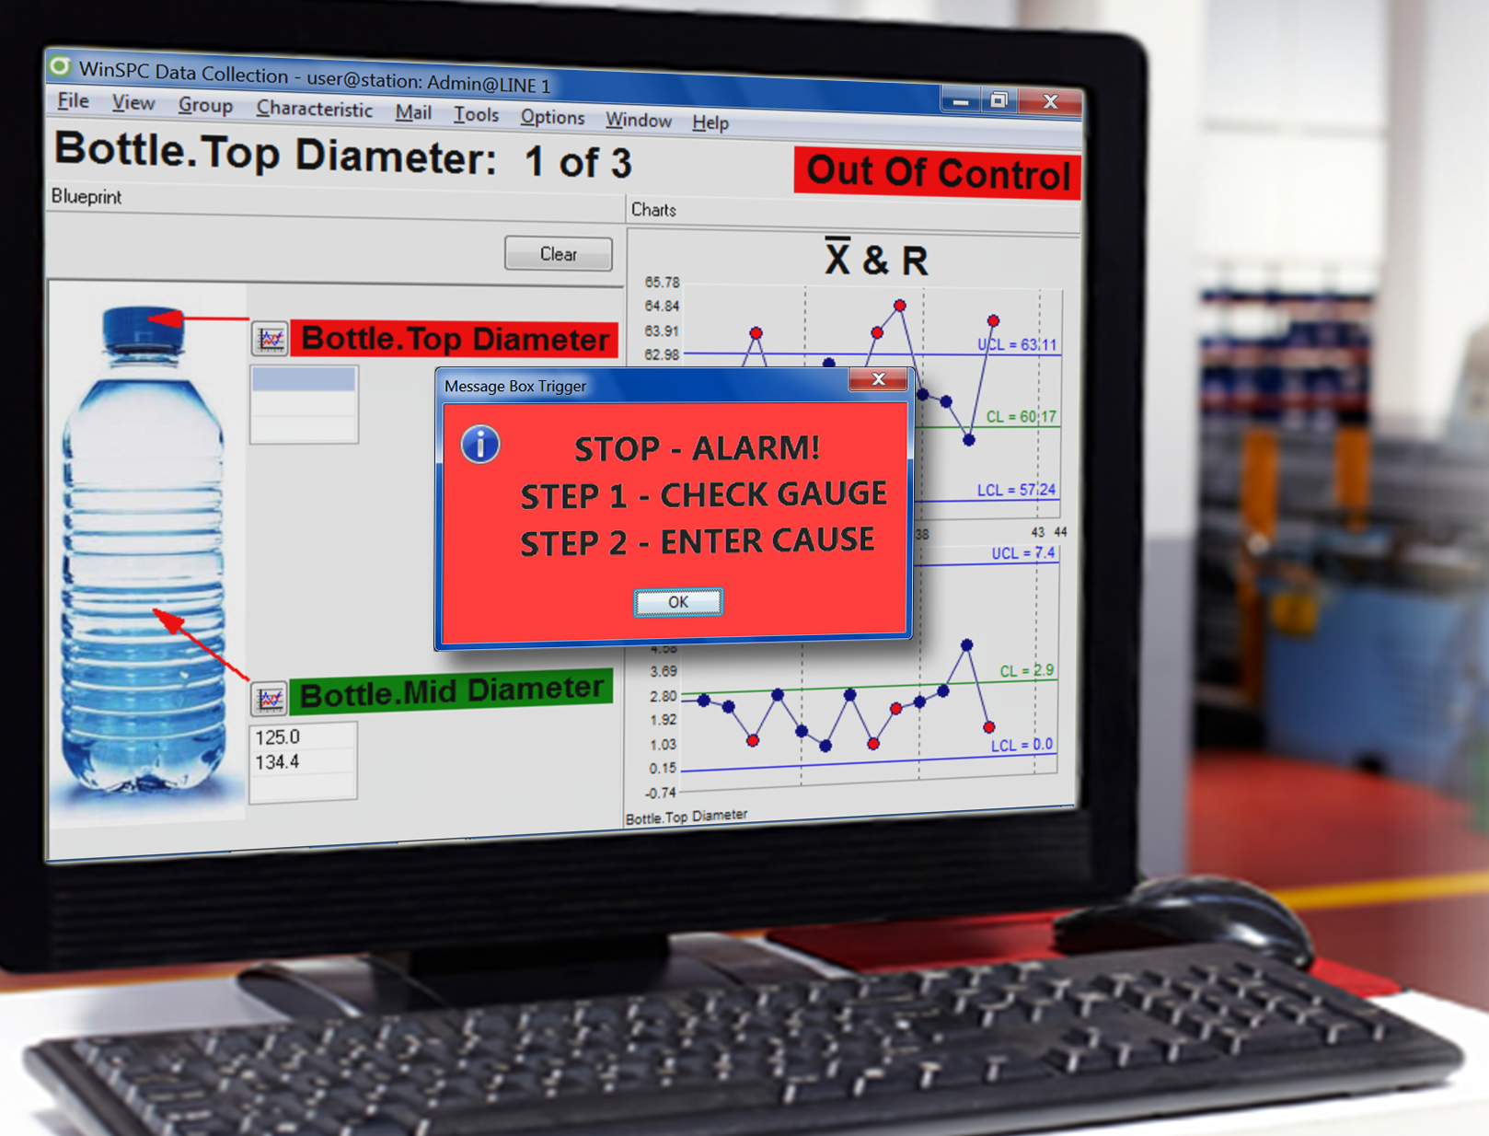

WHY DO SPC?
BENEFITS OF AUTOMATED SPC
Statistical Process Control
SPC helps manufacturers make the HIGHEST QUALITY PRODUCT at the LOWEST POSSIBLE COST.
MONITOR PROCESSES IN REAL-TIME
Improve Quality
Reduce Process variation, scrap & rework
Eliminate paperwork
Comply with customer & regulatory requirements
SPC monitors the performance of a process and, using statistics, helps IDENTIFY TRENDS and VARIATION to prevent the process from going out of control.
©2019 DataNet Quality Systems

Slide 2
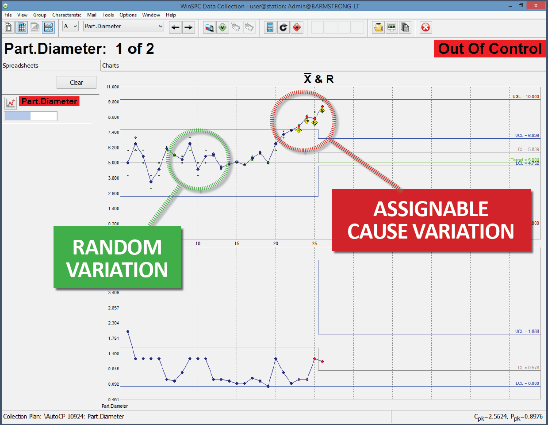

VARIATION
In SPC, variation refers to differences in observed measurements from the expected target value.
KEY TERMS
MEAN | AVERAGE of MEASUREMENTS
SIGMA | SPREAD of MEASUREMENTS
(process distribution)
STANDARD DEVIATION | The EXTENT of VARIATION
for a set of data values
SUBGROUP | GROUP of MEASUREMENTS used
to plot a point
ALL PROCESSES HAVE VARIATION
RANDOM VARIATION is normal and expected.
ASSIGNABLE CAUSE VARIATION is the result of at least one
EXTERNAL INFLUENCE and indicates a process is OUT OF CONTROL.
©2019 DataNet Quality Systems

Slide 3
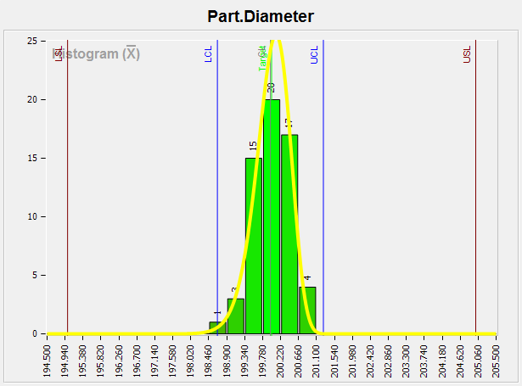
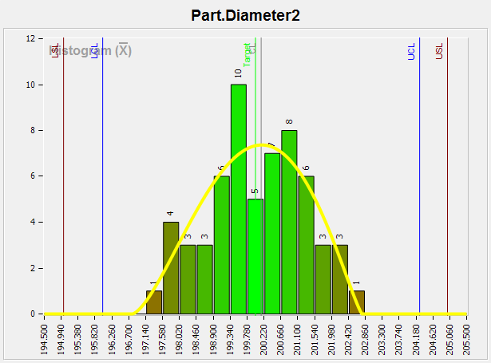
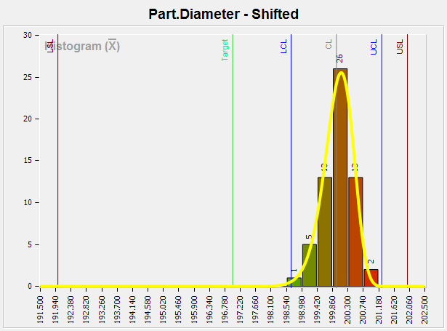
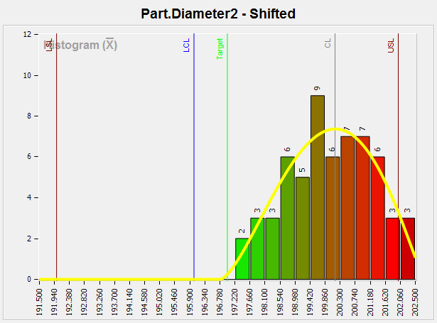
High Cpk | High Cp
Cpk = 1.68 | Cp = 1.68
Low Cpk | Low Cp
Cpk = .53 | Cp = .53
PROCESS
CAPABILITY
A method of analyzing a process to determine its capacity to produce units within specification limits.
KEY TERMS
Low Cpk | High Cp
Cpk = .67 | Cp = 1.68
Low Cpk | Low Cp
Cpk = .21 | Cp = .53
HISTOGRAM | TALLY of MEASUREMENTS that
shows the DATA DISTRIBUTION
CP | Indicates the DISTRIBUTION WIDTH for the data (Target Cp > 1.3)
CPK | Indicates the data WIDTH AND CENTERING
relative to SPECIFICATIONS (Target Cpk > 1.3)
©2019 DataNet Quality Systems

Slide 4
SPECIFICATION LIMITS
LIMITS
Range of acceptable measurements from the CUSTOMER
NOTE: A point outside the specification limits
indicates that the part is out of tolerance (defective).
CONTROL LIMITS
Region based on SPC theory to guide PROCESS IMPROVEMENT
NOTE: A point outside the control limits indicates that the process is out of control.
©2019 DataNet Quality Systems

Slide 5
A PLOT OF DATA AGAINST CONTROL LIMITS
CONTROL CHART
A chart to visualize process performance against calculated control limits and to reveal variation among measurements.
KEY TERMS
XBAR Chart | PLOTS the AVERAGE of a subgroup’s measurements
LIMIT VIOLATION
Range Chart | PLOTS the RANGE between
a subgroup’s high and low members
A subgroup value exceeds the
UPPER CONTROL LIMIT (UCL)
indicating that the process is
OUT of CONTROL.
X Chart | PLOTS each INDIVIDUAL
measurement on its own
MR Chart | PLOTS the MOVING RANGE
between successive measurements
©2019 DataNet Quality Systems

